Slide 1
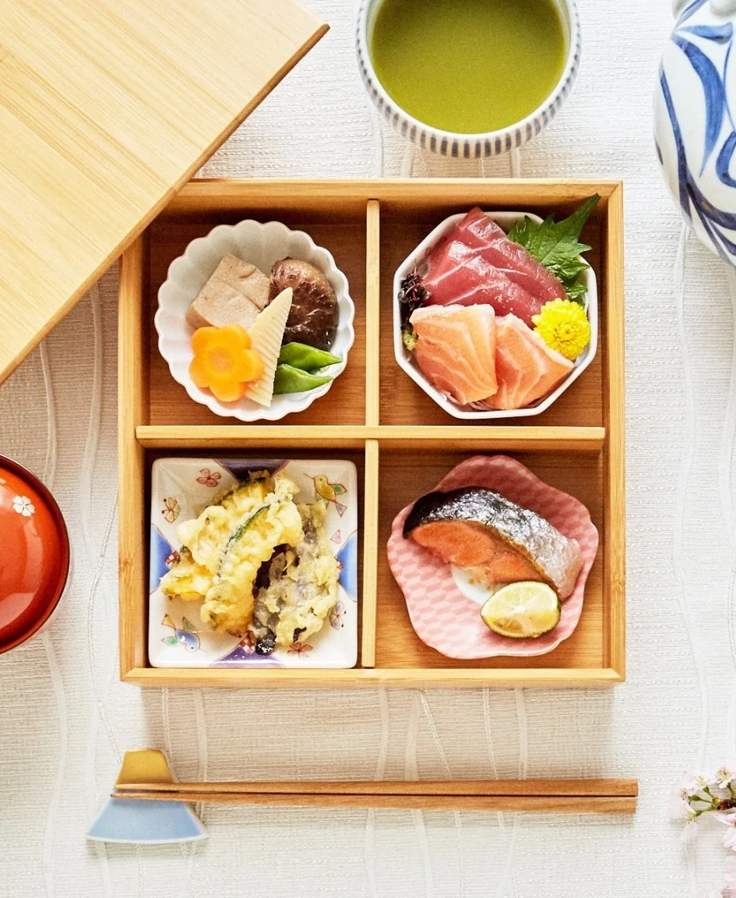
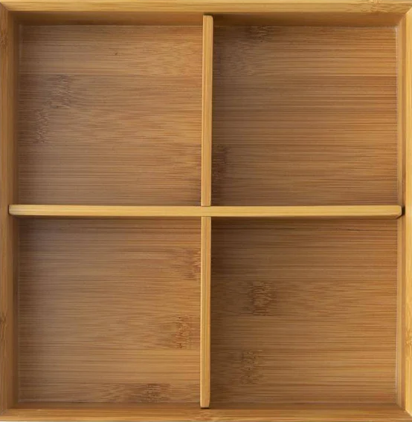
BENTO SOUL MARTEL
This virtual lunchbox is divided into sections like a traditional Japanese bento and is waiting to be filled with foods of your choice!
BENTO helps the user create a lunchbox by making selections from various categories of food.

